Slide 1
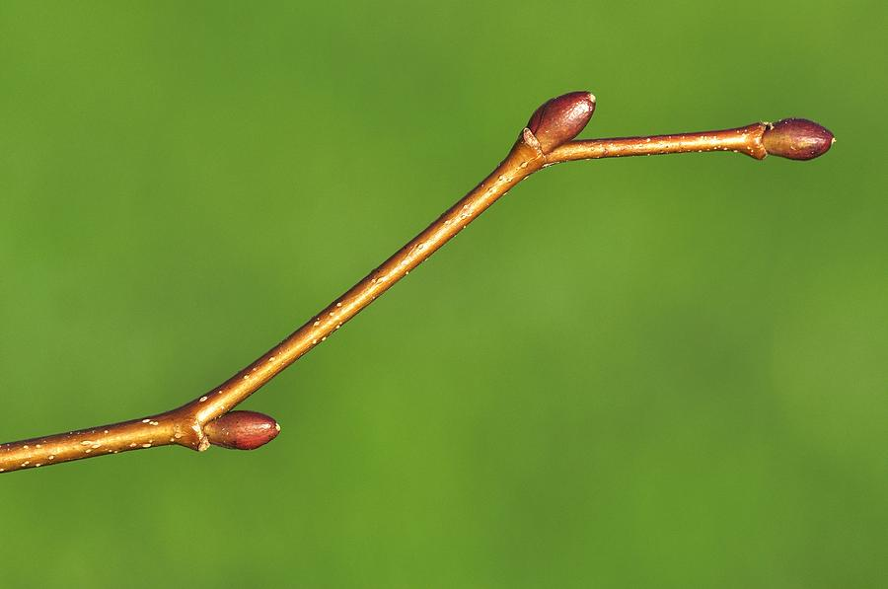
If I could measure 6000 buds in a day: A statistical story of temporal bias correction and the phenology that went with it

Slide 2
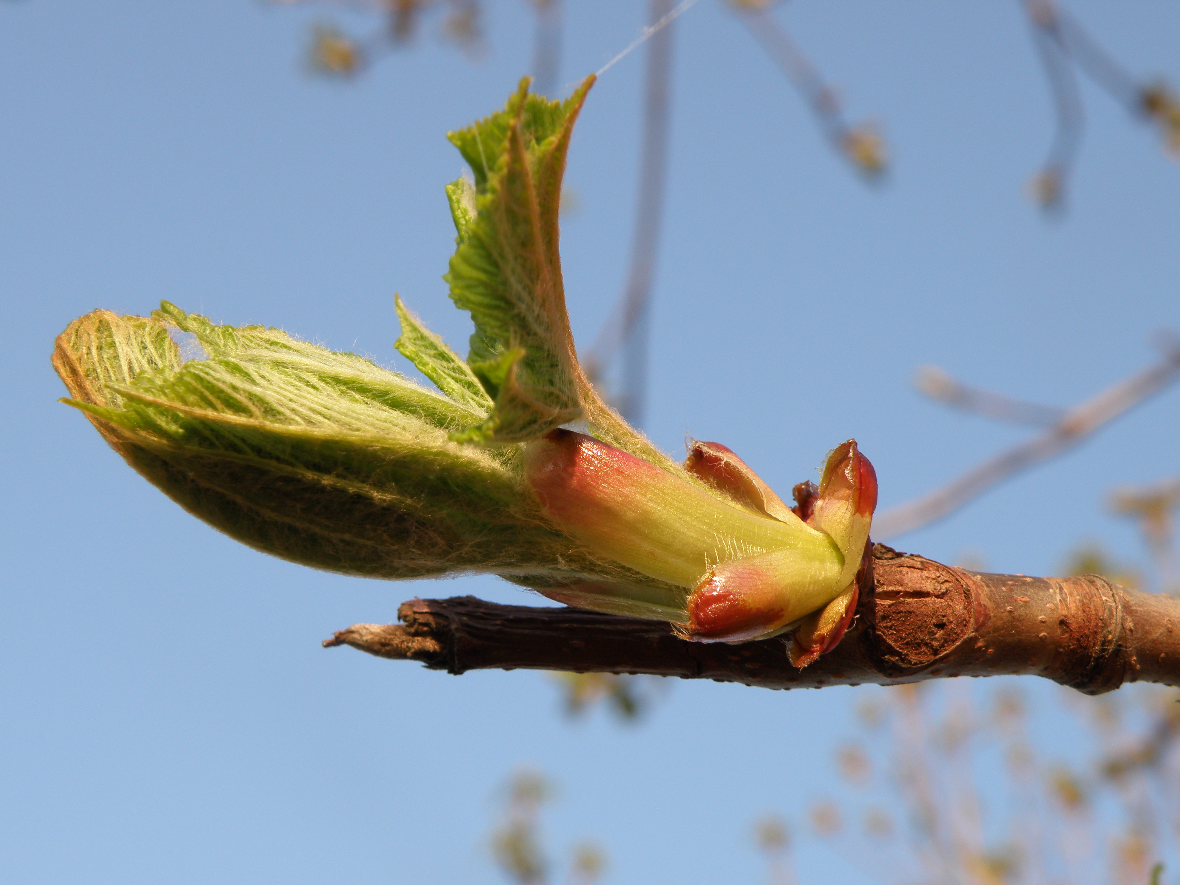
Data set 1:
6467 rows of bud volume
27 species (6 reps/species)
2 sites
(bud level)
Data set 2:
2136 rows phenological observations
12 experimental treatments
(twig level)
Does bud size predict phenological order?
Hypothesis: Larger buds burst earlier

Slide 4
T1
T2

Slide 5
